Slide 1

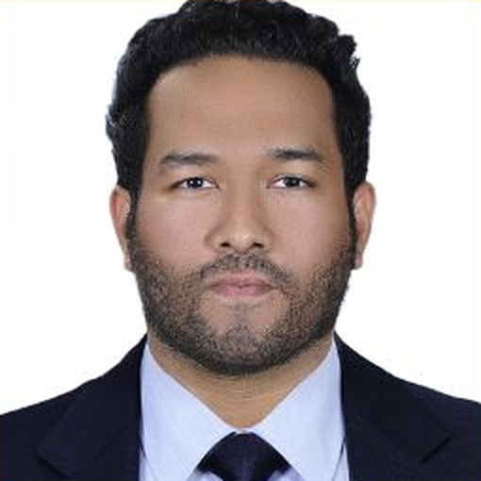
Multi-Turn Reinforcement Learning on Amazon SageMaker
From Concepts to Practice
Isham Rashik
AI Engineer · Future OS, Expo City, Dubai
AWS COMMUNITY DAY
Date: Saturday, 3 October 2026
Location: Deriv office, One by Omniyat, Business Bay, Dubai
UAE
5TH EDITION
Notes:
0:00 to 0:30 · Welcome
Welcome. I'm Isham Rashik, AI Engineer at Future OS in Expo City Dubai. In the next 20 minutes: how an AI support agent learned to make better decisions across a whole conversation, using multi-turn reinforcement learning on Amazon SageMaker AI.
Part 1 is the ideas, about 7 minutes, no maths. Part 2 is a real run on AWS with real numbers, about 10 minutes. Then your questions. Every number you'll see comes from runs on AWS on 1 and 2 October.

Slide 2

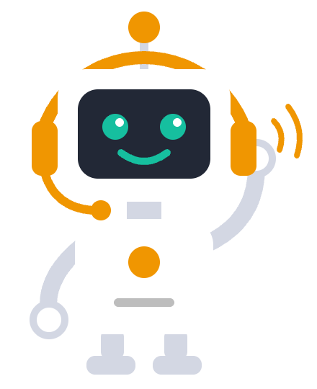
Introduction to Reinforcement Learning
PART 1
Notes:
0:30 · Part 1 (a few seconds)
Part 1: an introduction to reinforcement learning, then where SageMaker fits. Our robot says hello; it will learn a lot in the next 20 minutes. Move straight on.

Slide 3
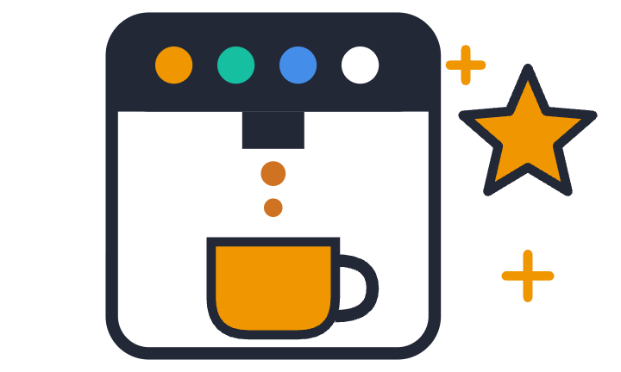
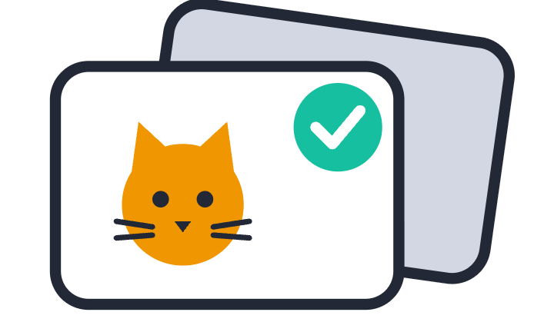
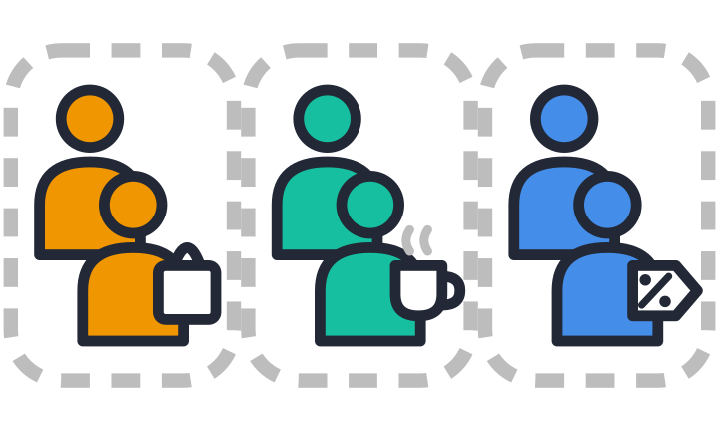
Three ways machines learn
Reinforcement
Supervised
Unsupervised
Learns from a score
Learns from answers
Finds groups by itself
This talk
Notes:
0:30 to 1:30 · Three ways machines learn
Supervised learning learns from answers, like flashcards with the answer on the back: show it thousands of photos tagged cat or dog, and it learns to tag new ones.
Unsupervised learning finds groups by itself, like a shop sorting its customers by how they buy: big weekly shoppers, morning coffee regulars, bargain hunters. Nobody gave it those labels; it spotted the groups in the purchase data.
Reinforcement learning learns from a score, by trial and error, like a new office coffee machine: you press buttons until coffee comes out, then remember which ones worked.
The key difference: supervised learning needs the right answer for every example; reinforcement learning only needs a way to score the result. Our support agent is the third kind.

Slide 4
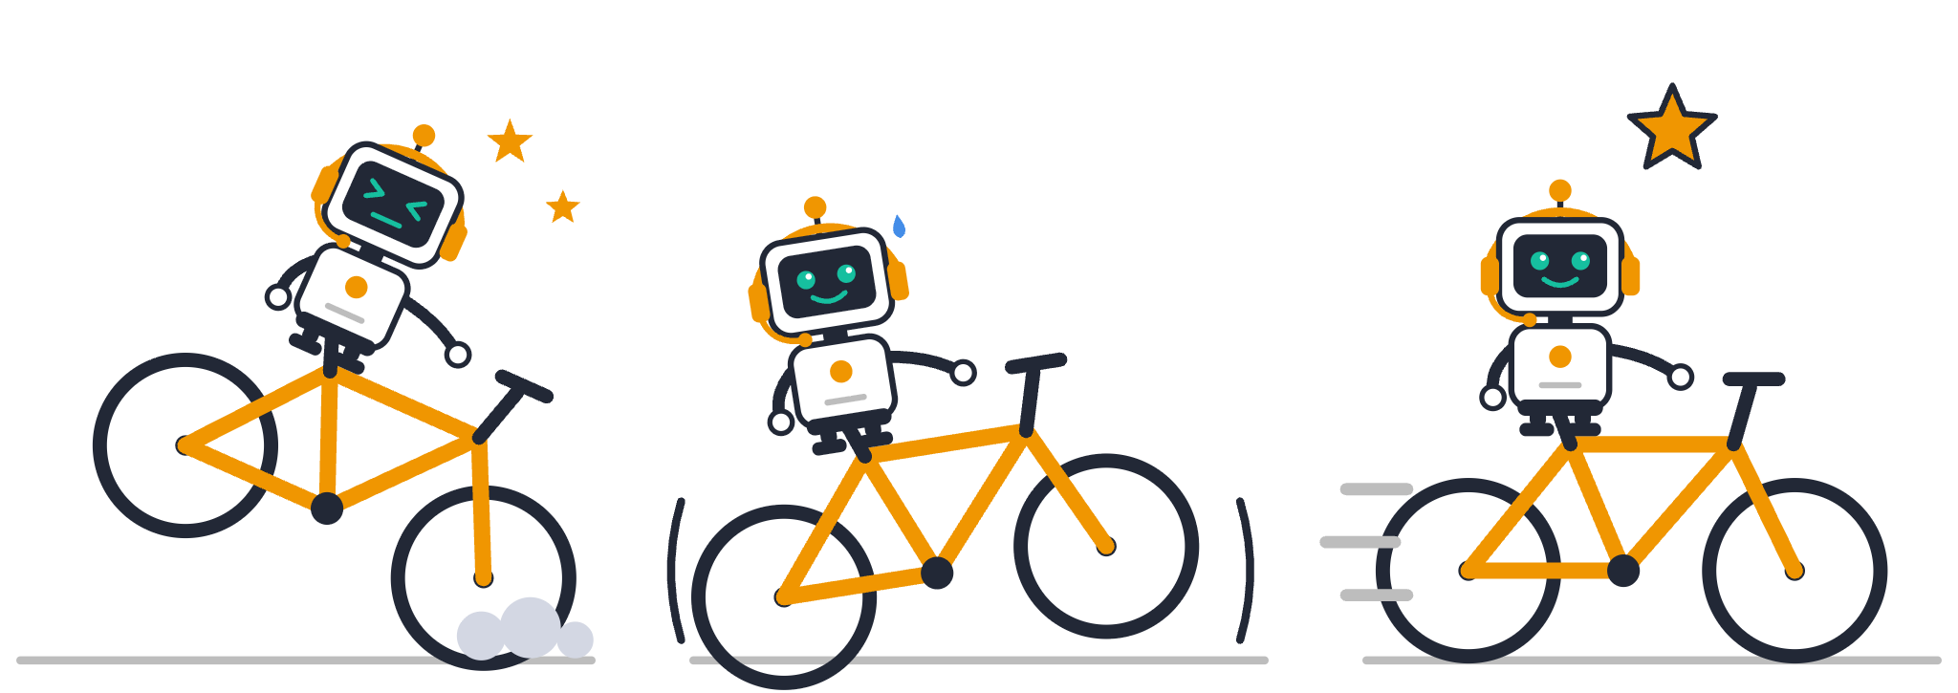
Learning by trial and error
Fall
Wobble
Ride
Agent: the rider
Environment: the road
Reward: staying up
Notes:
1:30 to 2:00 · Learning by trial and error
Think of a child learning to ride a bike; here it's our robot. First try: it falls. Next tries: it wobbles. Eventually: it rides, and gets a star. Nobody hands it a manual; it learns from what happens.
Notice the labels at the bottom: agent, environment, reward. The next slide shows how they fit together.

Slide 5
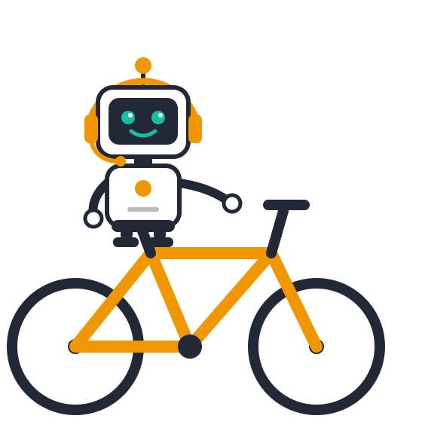

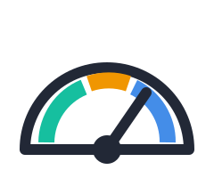
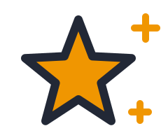
The RL loop aka MDP – Markov Decision Process
Action
what it does
Bike: pedal, steer
Agent
Environment
decides what to do
State
Reward
the world it acts in
Bike: the rider
what it sees now
how well it did
Bike: the road
Bike: speed, wobble
Bike: staying up
See the state. Act. Get the reward. Repeat.
Notes:
2:00 to 3:00 · The RL loop
The words from the bike, plus one. The agent decides what to do: the rider. The environment is the world it acts in: the road. The state is what the agent sees right now: its speed and its wobble. The reward is how well it did: staying up.
The loop: the agent reads the state and takes an action (pedal, steer). The environment answers with a new state and a reward. Then again, thousands of times. That's how AI agents learn to act, not just talk.
Bridge to Part 2: same loop, different world. The agent is our support bot, the environment is a support simulator, the state is what the ticket looks like now (say, the router light is red), and the reward is 0.25 for every right step.
If asked about the title: a Markov decision process, or MDP, is the textbook name for this loop. "Markov" means the next state depends only on the current state and the action, not on the whole history.

Slide 6
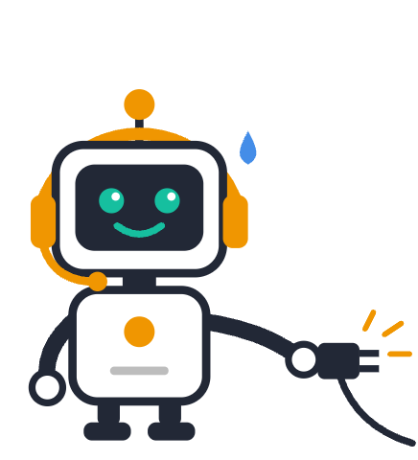
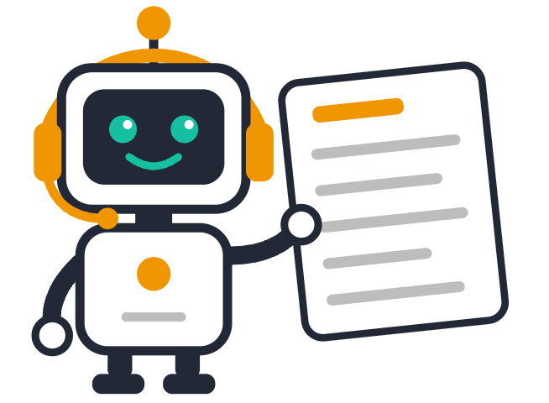
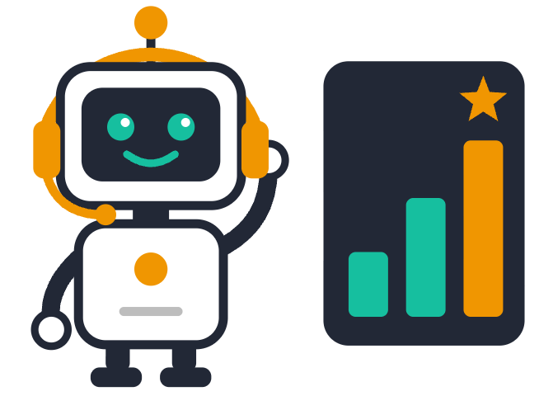
Why not just…?
Better instructions?
Fine-tuning?
Learn from a score
It knew the rules. Still pulled the plug.
Needs a perfect reply for every turn.
Needs only tickets and a score.
Not enough
Costly to write
Our pick
Fine-tuning makes it sound right. RL makes it fix things.
Notes:
5:30 to 6:15 · Why not just…?
Better instructions? A spoiler from Part 2: the model already had the rules and the list of moves in its instructions, and it still pulled the plug first. Instructions can't easily teach judgement across turns.
Fine-tuning on examples? Someone has to write the perfect reply for every turn of every ticket, and the model only copies them; it never sees what its own moves lead to.
Learning from a score needs only tickets and a way to score the result. That's our pick.
Fine-tuning makes it sound right; RL makes it fix things.
If asked: many teams do both, fine-tuning first for format and tone, then RL for decisions.

Slide 7




How RL shaped the LLMs you use
2022
2024
2025
Now
ChatGPT
Reasoning models
DeepSeek-R1
Agents
Human ratings made it helpful
Learned to think before answering
An open model that learned to reason with RL
Learn to act, step by step
This talk
Pre-training reads the internet. RL teaches it to behave.
Notes:
3:00 to 3:30 · How RL shaped the LLMs you use
Pre-training is reading: a model reads a huge slice of the internet. That makes it fluent, not helpful. RL is what made it useful: in 2022 ChatGPT learned from human feedback; in 2024 reasoning models such as OpenAI o1 learned to think before answering; in 2025 DeepSeek-R1 put the recipe in the open; and now agents learn to act, which is this talk.
Punchline: pre-training reads the internet; RL teaches it to behave. Next: the same RL loop inside ChatGPT and DeepSeek-R1.
If asked: OpenAI's model card says GPT-OSS, the model we used, was itself post-trained with a large RL stage; we just gave it extra practice on our task.

Slide 8
Same loop, two famous models
ChatGPT
DeepSeek-R1
2022 · RLHF
2025 · reasoning RL
Agent
The language model
The DeepSeek model
Environment
Chats built from training prompts
Reasoning problems and tasks
State
Prompt + chat + reply so far
Prompt + reasoning so far
Reward
Higher when people prefer the reply
Correct answers + desirable reasoning and output
Same loop. Different world. Different reward.
Notes:
3:30 to 4:15 · Same loop, two famous models
The four words from the loop fit both of these models. Read it column by column.
ChatGPT, 2022, trained with RLHF: the agent is the language model; the environment is conversations built from training prompts; the state is the prompt, the conversation so far and the reply generated so far; the reward is higher when people rank the reply as better. In practice a reward model, trained on those human rankings, does the scoring.
DeepSeek-R1, 2025, reasoning RL: the agent is the DeepSeek model; the environment is reasoning problems and tasks; the state is the prompt plus its reasoning so far; the reward is for correct answers and desirable reasoning and output behaviour (its paper's rewards check accuracy and format).
OpenAI o1, from the timeline, follows the same reasoning-RL idea as R1; R1's recipe is the one that's public.
Next: our own support agent, in the same words.

Slide 9
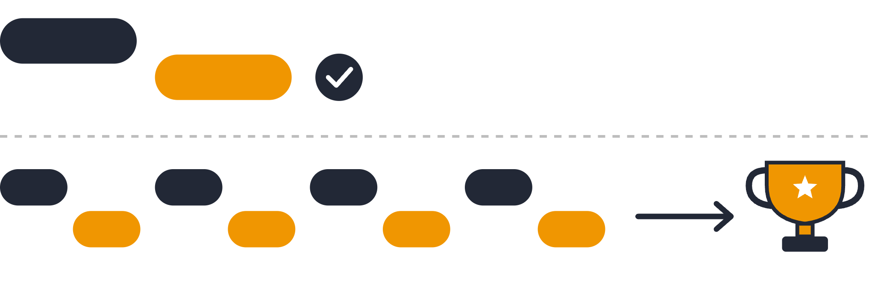
One answer vs a whole conversation
Single turn
Multi-turn
Points for every right step. Full marks when it’s solved.
Notes:
6:15 to 6:45 · What multi-turn means
Single turn: one question, one answer, done. Multi-turn: a whole conversation, where every move changes what happens next, like a support chat that has to end with the problem fixed.
One good reply is not the same as finishing the job. So we score the whole conversation: in our run, a quarter point for every right step, and full marks only when the ticket is solved.

Slide 10
Demo:
RL meets SageMaker
PART 2
Real run. Real numbers.
Notes:
7:30 · Part 2 (a few seconds)
Part 2: the demo, about 10 minutes. A real run on AWS on 1 and 2 October: a real agent, a real training job, real numbers.

Slide 11
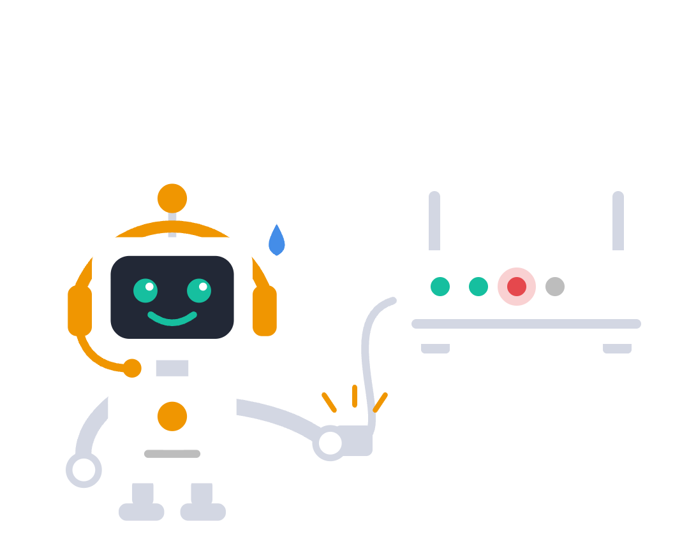
Meet our support agent
Customer:
“My internet is down!”
Goal: fix it in 4 moves
What should it do first?
A Restart the router
B Check for an outage
C Close the ticket
Notes:
7:30 to 8:30 · Meet our support agent
Meet our support agent: a small AI agent running on Amazon Bedrock AgentCore with the GPT-OSS-20B model. The customer says: my internet is down. Its goal: fix it within 4 moves.
Ask the room: what should it do first? Hands up for A, restart the router; B, check for an outage; C, close the ticket. Point at the small print: be honest, it's A.
Then click: our robot pops up, already holding the plug. Most people pick A, and so did our AI before training. Let the laugh land, and hold that thought: it comes back in "Same ticket, two models".

Slide 12
Our support agent MDP
Agent
The AI support agent, choosing the next troubleshooting step
Environment
The support simulator: it responds to each move and updates the ticket
State
The ticket so far: “router light is red”
Action
Check outage, lights or account; restart, escalate, apply fix…
Reward
+0.25 per helpful step, 1.0 when solved; a wrong move scores 0 and uses up a turn
Ticket → action → simulator responds → reward → better decisions next time.
Notes:
4:15 to 5:00 · Same loop, our support agent
Say it as the questions the agent asks itself. Agent: what should I do next? Environment: what happens after I act? State: what do I know right now? Action: which move do I make? Reward: did that move bring me closer to solving the ticket?
In our run, the agent is the AI support agent deciding which troubleshooting step to take next. The environment is the support simulator, which responds to each action and updates what happens next. The state is the current ticket situation plus what has already happened in the conversation, for example "no outage nearby", "router light is red", "account settings are wrong". The actions are the moves: check outage, check router lights, check account, restart router, escalate, apply fix and so on. The reward is +0.25 for each helpful step and 1.0 when the ticket is fully solved; a wrong move gets no reward and uses up one of the limited turns.
The full loop: a ticket comes in, the agent chooses an action, the simulator responds, a reward is given, and the agent learns to make better decisions next time.

Slide 13










The training loop on SageMaker
1 Ticket
2 Agent
3 Model
“My internet is down”
runs on AgentCore
GPT-OSS-20B
SageMaker runs it. You babysit zero GPUs.
6 Update
5 Score
4 Environment
a small LoRA add-on
0.25 per right step
a support simulator
Notes:
6:45 to 7:30 · Where SageMaker fits
Walk the loop once. SageMaker hands a ticket to our agent, which runs on Amazon Bedrock AgentCore. The agent asks the model, GPT-OSS-20B, for its next move. The environment, a support simulator, applies the move, says what happened and scores it: 0.25 per right step, 1.0 when solved.
SageMaker then nudges a small add-on to the model, called LoRA (the base model stays unchanged), and runs the next round.
It's serverless: you babysit zero GPUs, and you pay per token.

Slide 14
1. The data
64
32
training tickets
held-out test tickets
data/training_prompts.csv
data/evaluation_prompts.csv
used for practice
kept aside, never trained on
Each row is just one opening message, e.g. “My Wi-Fi works, but websites do not load.”
No answers, no labels: the simulator does the scoring.
Notes:
How training works, step 1 of 7: the data
Two files and nothing else: 64 training tickets for practice, and 32 held-out tickets kept aside for the test. Each row is just the customer's opening message. There are no answers or labels; the simulator scores every move.

Slide 15
2. The training loop
1
2
3
4
Take 32 tickets
Try each 4 times
Score every chat
Nudge the model
of the 64; two rounds use all 64
32 × 4 = 128 conversations
a reward from 0.0 to 1.0
only its small LoRA add-on
the next round uses the updated model
10
1,280
rounds
conversations
Every training ticket: 5 rounds × 4 tries = 20 practice chats
Notes:
How training works, step 2 of 7: the training loop
Each round takes 32 of the 64 tickets, and the agent tries each one four times: 128 conversations. Every conversation gets a score, then SageMaker nudges the model, only its small LoRA add-on, and the next round uses the updated model. Ten rounds: 1,280 conversations in 19.2 minutes for $2.83. Every training ticket comes up in five rounds, four tries each.

Slide 16
3. One conversation
Agent
what next?
GPT-OSS-20B
a ticket
runs on AgentCore
plus its LoRA add-on
a move
SageMaker
hands out a ticket, collects the reward
the move
new state + moves left
The base model stays frozen; only the small LoRA add-on learns.
Support simulator
the reward, at the end
applies the move, keeps score
Up to 4 turns, or until solved; then the reward goes back to SageMaker.
Notes:
How training works, step 3 of 7: one conversation
SageMaker hands a ticket to our agent on AgentCore. The agent asks GPT-OSS-20B what to do next, the model picks a move, and the simulator applies it and sends back the new state and the moves left. Up to four turns, or until it's solved; then the reward goes back to SageMaker. The base model stays frozen; only the LoRA add-on learns.

Slide 17
4. The simulator
New ticket
No outage
Red WAN light
Config mismatch
Resolved
check outage
check lights
check account
apply fix
Wrong moves
restart router
replace router
escalate
close ticket
The state stays the same, but the turn is used up.
Move order is shuffled every time, so it can't memorise positions.
Notes:
How training works, step 4 of 7: the simulator
Four steps, one right move each: check for an outage, check the router lights, check the account, apply the fix. The wrong moves (restart or replace the router, escalate, close the ticket) leave the state unchanged and use up a turn. The order the moves are listed in is shuffled every time, so the model can't just learn positions.

Slide 18
5. The reward
Turn 1
Turn 2
Turn 3
Turn 4
Reward
Perfect
check outage
check lights
check account
apply fix
1.00
One slip
✗ restart router
check outage
check lights
check account
0.75
Two slips
✗ restart router
✗ close ticket
check outage
check lights
0.50
0.25 for each correct step · 1.0 only when solved · a wrong move scores nothing and uses a turn
reward = correct steps ÷ 4
Notes:
How training works, step 5 of 7: the reward
The reward is correct steps divided by four: 0.25 per correct step, and 1.0 only when the ticket is solved. One wrong move costs a turn, so the best it can then do is 0.75; two wrong moves, 0.5.

Slide 19
6. How it learns from 4 tries
Try A
Try B
Try C
Try D
1.00
0.75
1.00
0.50
more likely
less likely
more likely
less likely
Group average 0.81: above it, do more of that; below it, do less.
Only the small LoRA add-on changes; the base model stays frozen. (These four scores are an illustration.)
Average training reward: 0.89 in round 1 → 0.96 in round 10
Notes:
How training works, step 6 of 7: how it learns
For each ticket, the four tries are compared with each other. Tries that score above their group's average make their moves more likely; tries below it make theirs less likely. No answer key, just better or worse than its own attempts. These four scores are an illustration. Across training, the average reward rose from 0.89 in round 1 to 0.96 in round 10.

Slide 20
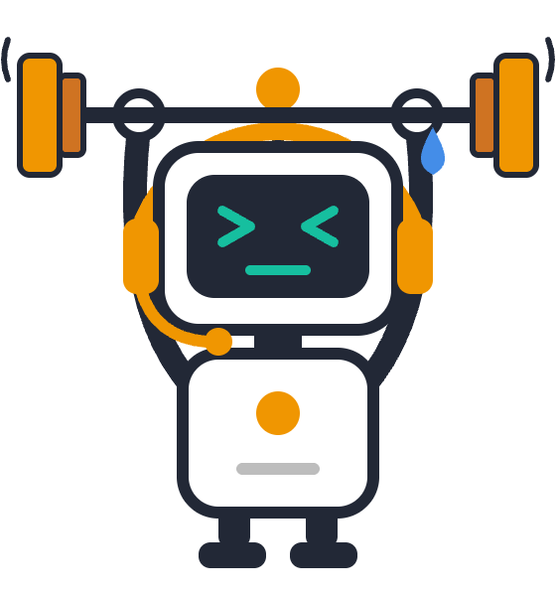
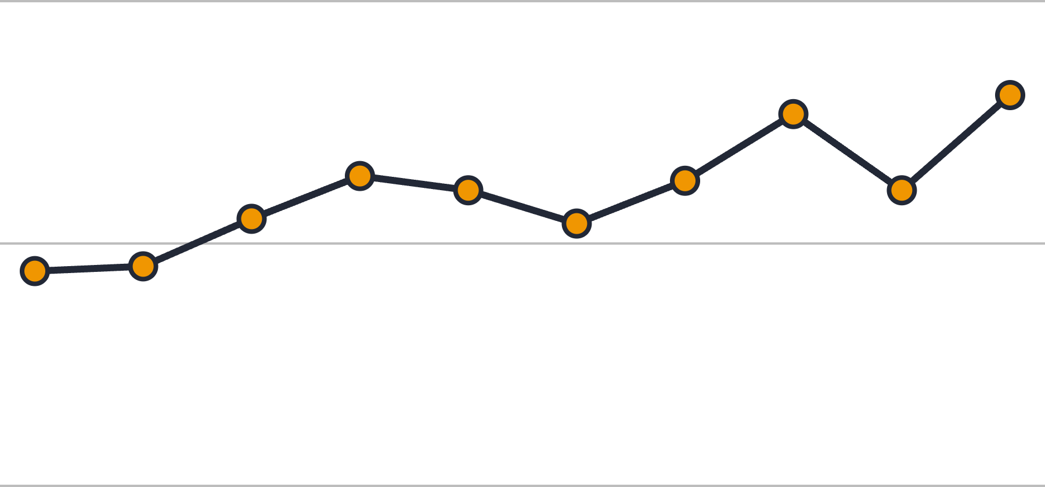
7. The Training results
Score per round
1.0
0.96
0.9
0.89
Trained for:
19 min
0.8
Round 1
Round 10
Notes:
10:30 to 12:00 · Training, recorded
10 rounds × 32 tickets × 4 tries = 1,280 practice conversations, in 19 minutes: shorter than this talk. It cost $2.83, billed per token: cheaper than a cappuccino in Business Bay. The robot with the barbell: this is its gym.
In plain words: 64 customer tickets, each practised 20 times. Each ticket comes up in 5 of the 10 rounds, with 4 tries each time.
If asked why only 32 tickets a round: all 64 are used. 32 is the batch size, the number of tickets each learning update uses, so two rounds make one full pass over the 64 and ten rounds make five passes. Smaller batches give more learning updates for the same spend: the same 1,280 conversations make 10 updates instead of 5. Using all 64 in every round for 10 rounds would roughly double the time and the cost, to about 40 minutes and $5.70.
The average score, with partial credit, climbed from 0.89 in round 1 to 0.96 in round 10; the chart starts at 0.8 so the change is visible.
These are training tickets, so it could simply have got good at those. The real test is next: tickets it has never seen.
Source: the SageMaker training job on 2 October 2026, 19.2 minutes. Optional: show the job in the SageMaker console, without zooming in on account IDs.

Slide 21
8. The test
32 held-out tickets × 2 tries each · same agent · same instructions
Before
After
Fully solved (pass@1)
0.58
0.78
37 → 50 chats solved
Solved in 1 of 2 tries (pass@2)
0.81
0.94
26 → 30 tickets
Mean reward (with partial credit)
0.88
0.93
partial credit included
+20 points on tickets it never saw
Notes:
How training works, step 7 of 7: the test
Then the real test: 32 held-out tickets it never saw, two tries each, with the same agent and instructions, base model vs trained model. Fully solved went from 0.58 to 0.78, solved within two tries from 0.81 to 0.94, and the average score from 0.88 to 0.93.

Slide 22
Not magic: ticket by ticket
+
+
+
+
+
+
+
+
+
+
+
+
+
=
=
=
=
=
=
=
=
=
=
=
=
=
−
−
−
−
−
−
13
13
6
+
better
=
the same
−
worse
Like any team after a training day.
Notes:
13:00 to 14:00 · Not magic
Each square is one of the 32 held-out tickets, comparing its average score before and after training: 13 got better, 13 stayed the same and 6 got worse.
Like any team after a training day: most improve, a few have an off day. With only two test tries per ticket (training used four), single tickets are noisy, so judge the total: 58% to 78% fully solved. Real progress, not magic; more rounds and more data would tighten it.

Slide 23
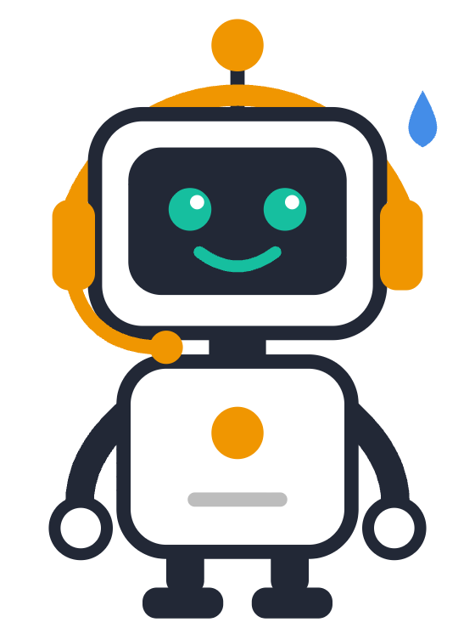
Would you trust the trained agent to complete this task?
A
Yes, ship it
B
Not yet
C
Only with a human watching
Agent + rewards + SageMaker = better decisions
Notes:
16:30 to 17:30 · Audience vote
Would you trust the trained agent to complete this task? Hands up: A, yes, ship it; B, not yet; C, only with a human watching. Point at the robot sweating while it waits for the verdict.
The honest answer is B or C: 78% needs monitoring, guardrails and a human hand-off. But it's +20 points from ten rounds of practice.
Then click for the band: agent plus rewards plus SageMaker equals better decisions. That's the whole talk in one line.

Slide 24




Where else could this work?
IT helpdesk
Account access
VPN, laptops, printers
Locked out? Step by step back in
Travel changes
New joiners
Rebook a missed flight
Laptop, email and badge on day one
Any job with several steps and a clear finish line.
Notes:
17:30 to 18:00 · Where else could this work?
The same recipe fits any job with several steps and a clear finish line you can score: IT helpdesks (VPN, laptops, printers), account access, travel changes such as rebooking a missed flight, and getting a new joiner set up on day one. These are ideas, not results from our run.

Slide 25
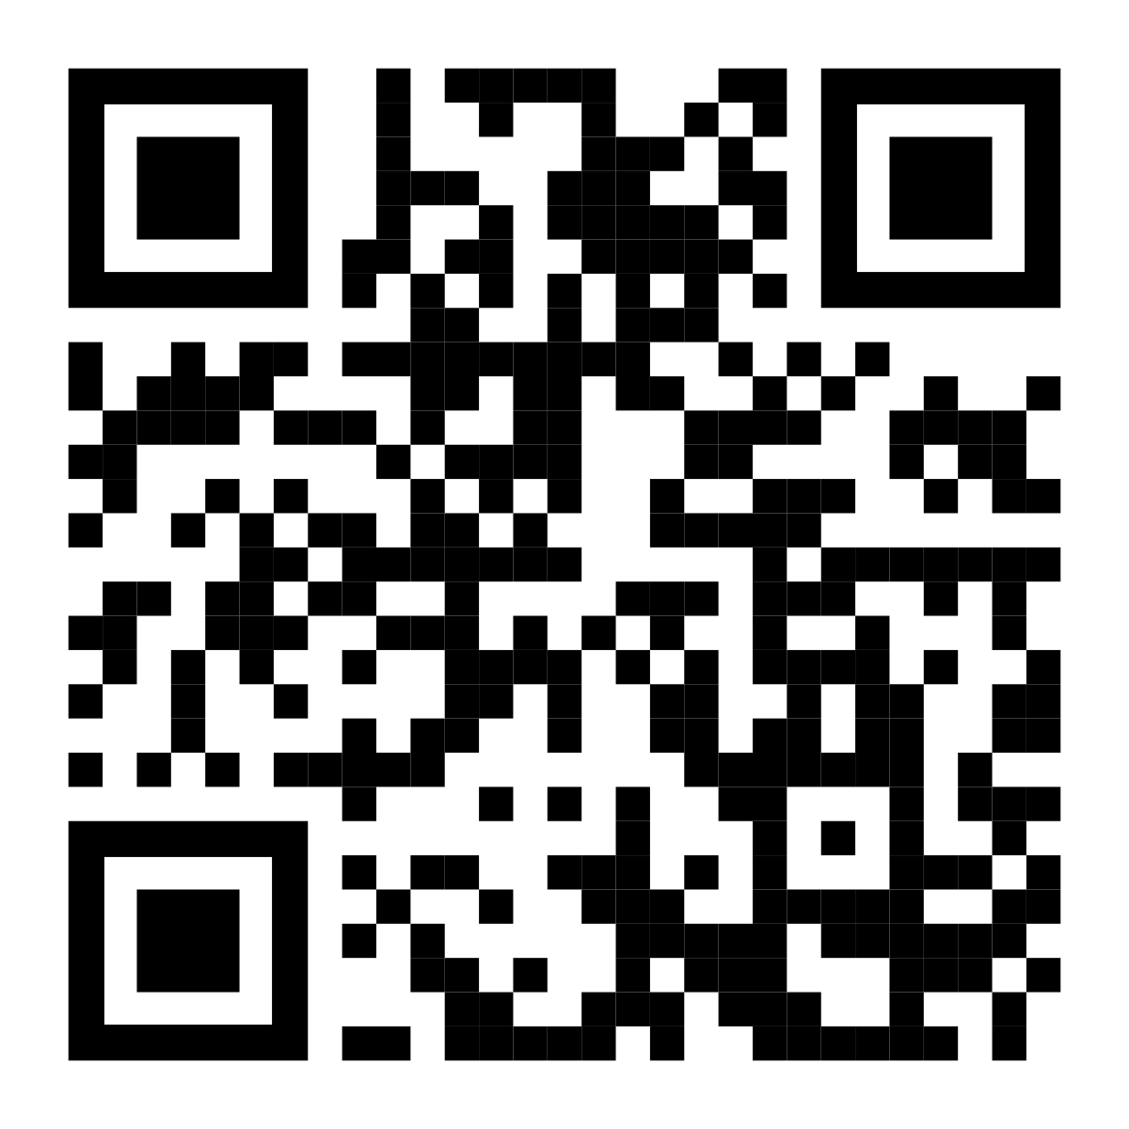
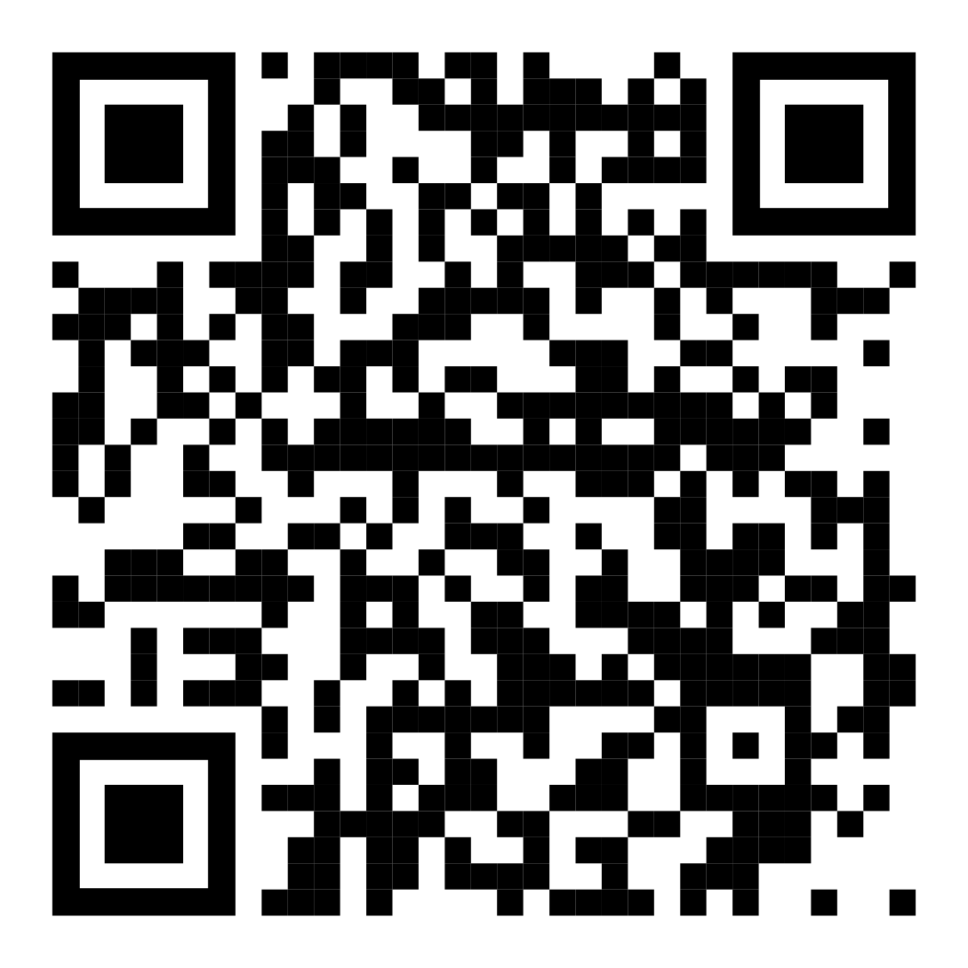
Three things to remember
Get the code
Connect on LinkedIn to keep up with AI
Learn from feedback
Improve across turns
Continue to Train
“The goal isn’t just to build AI that gives better answers. It’s to build AI that makes better decisions throughout an entire interaction.”
github.com/di37/aws-rl-workshop
linkedin.com/in/isham-rashik
Thank you!
Questions?
Notes:
18:00 to 20:00 · Three things to remember, then questions
Learn from feedback: a score, not a script, shaped its habits. Improve across turns: diagnose first, every turn counts. Continue to train: ten rounds took it from 58% to 78%, and the loop doesn't stop there: add rounds and fresh tickets and train again. On SageMaker, another run costs about $2.83 and 19 minutes.
Click to show the closing quote, and read it aloud. Thank you. Then point at the two codes: the left one opens the code on GitHub (rebuild every number offline for free, or repeat the study in your own AWS account for about $6–8); the right one is my LinkedIn. Leave this slide up and take 2 or 3 questions, short answers.
Why not better instructions? We kept the agent and the instructions identical; only the model's habits changed.
Cost and time? $5.78 in total, $2.83 of it for training; 19 minutes of training, about six hours end to end.
What is LoRA? A small set of add-on weights; the base model stays unchanged.
Why did 6 tickets get worse? Two tries per ticket is noisy; judge the total.
Did it memorise? No: it was tested on 32 held-out tickets it never trained on.
Could it cheat the reward? The score comes from the environment's state machine, so only real progress counts.
Why not a SageMaker endpoint? No GPU capacity at the time and nothing billed; Bedrock import is the guide's second option.
Can I reproduce it? Yes: every number rebuilds offline for free, and a full rerun costs about $6 to $8.

